Slide 1
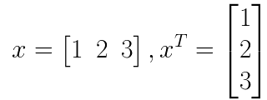
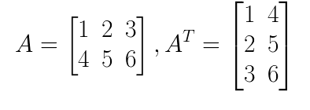
Some Basic Concepts
The transpose of a vector or matrix is obtained by interchanging the corresponding rows and columns. The transpose of A is denoted by A^{T}
If a matrix A is m by n (has m rows and n columns), then its transpose will have n rows and m columns
Examples:

Slide 2

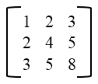
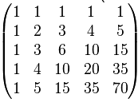

Some Basic Concepts
A matrix A is called square if it has an equal number of rows and columns.
Consider a square matrix A of size n X n. The matrix is called symmetric if:
More informally, a symmetric matrix remains unchanged if the corresponding rows and columns and inter-changed. Symmetric matrices are always square.
Examples:
2 X 2
3 X 3
5 X 5
For a symmetric matrix A, A = A^{T}

Slide 3

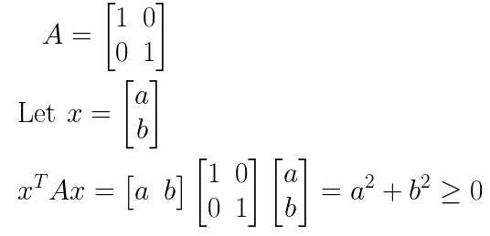
Some Basic Concepts
Consider a square matrix A of size n X n and let x be any vector of size n X 1. The matrix A is called Positive Semi-definite (PSD) if:
Example:
So, A is PSD

Slide 4
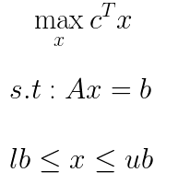
Some Basic Concepts
Objective Function / Cost Function
Variable
Optimization Problem
Constraints
Interpretation: Solve for the variable x in such a way that the value of the objective function is maximized (or minimized) and all the constraints are satisfied
An optimization problem where the cost function is linear in the variable and the constraints are also linear in the variable is called a linear programming (LP) problem
LP problems can be solved using solvers like linprog (Matlab)

Slide 5
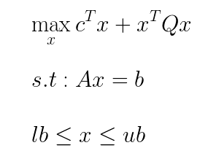
Some Basic Concepts
An optimization problem where the cost function is quadratic in the variable and the constraints are linear in the variable is called a quadratic programming (QP) problem
QP problems can be solved using solvers like quadprog (Matlab)
It is possible to have more than one variable in an LP or a QP problem

Slide 6
Support Vector Machines
A classification algorithm that has received considerable attention is support vector machines (SVMs)
Has its roots in statistical learning theory and has shown promising empirical results in many practical applications like handwritten digit recognition and text categorization
Works well with high dimensional data and avoids the curse of dimensionality problem
It represents the decision boundary using a subset of the training examples, known as the support vectors (hence the name support vector machine)
SVMs are also called maximum margin classifiers

Slide 7
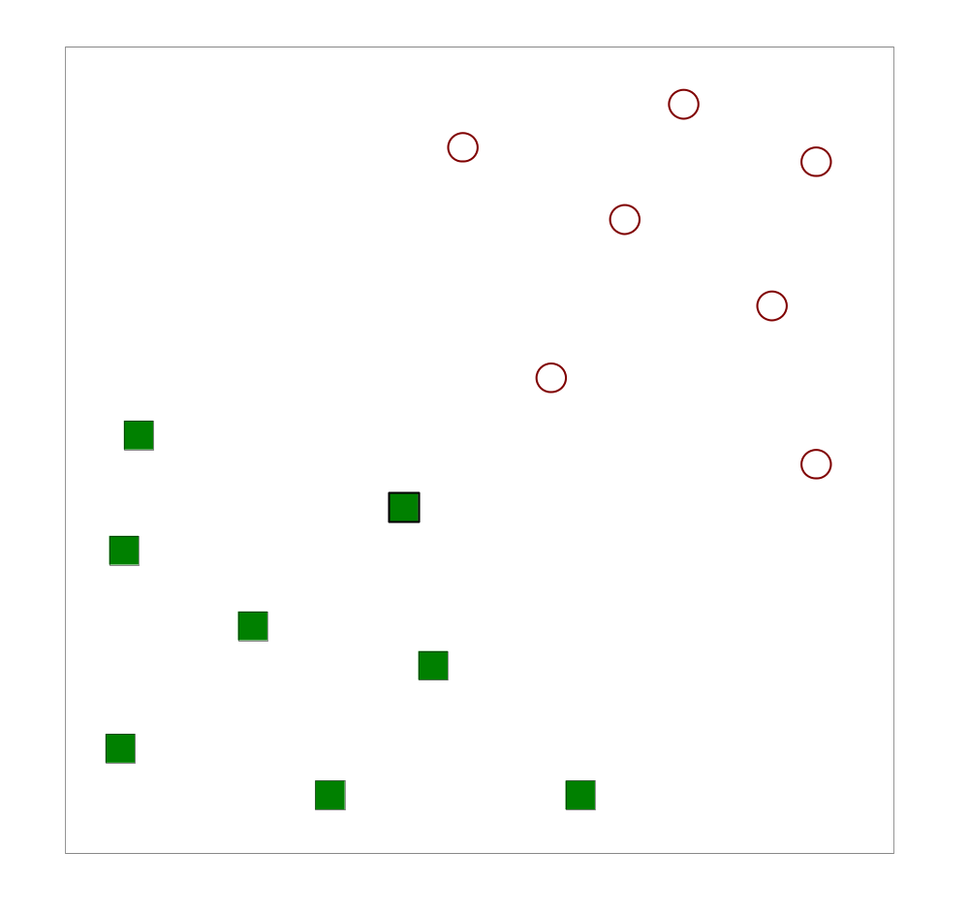
Support Vector Machines
Find a linear hyperplane (decision boundary) that will separate the data

Slide 8
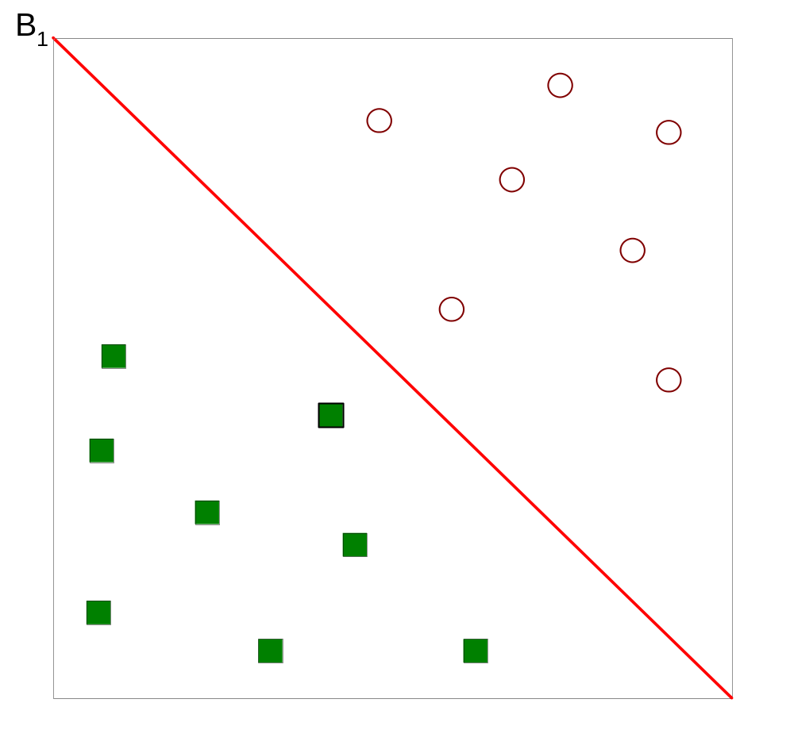
Support Vector Machines
One Possible Solution

Slide 9
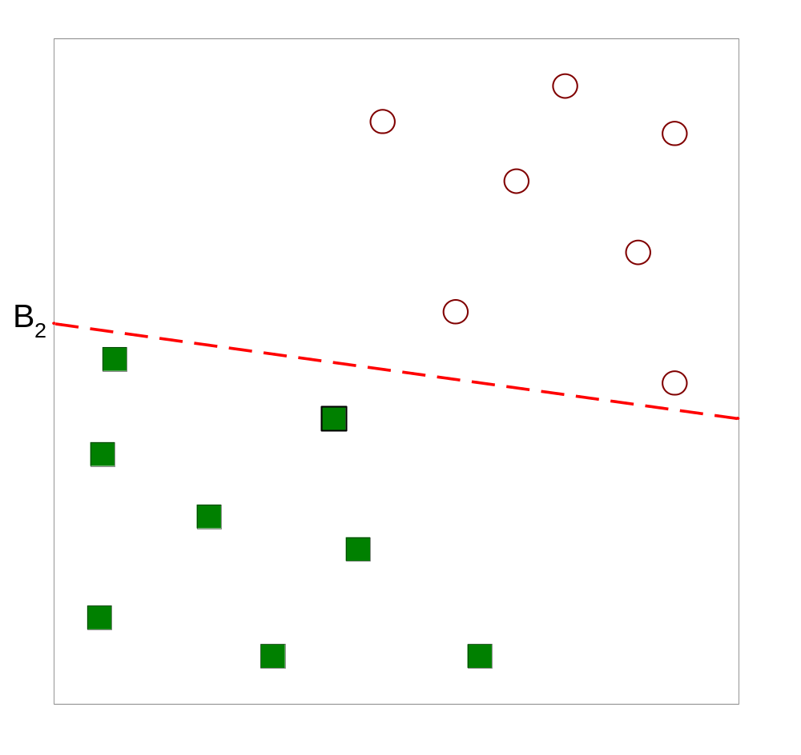
Support Vector Machines
Another possible solution

Slide 10
Support Vector Machines
Other possible solutions

Slide 11
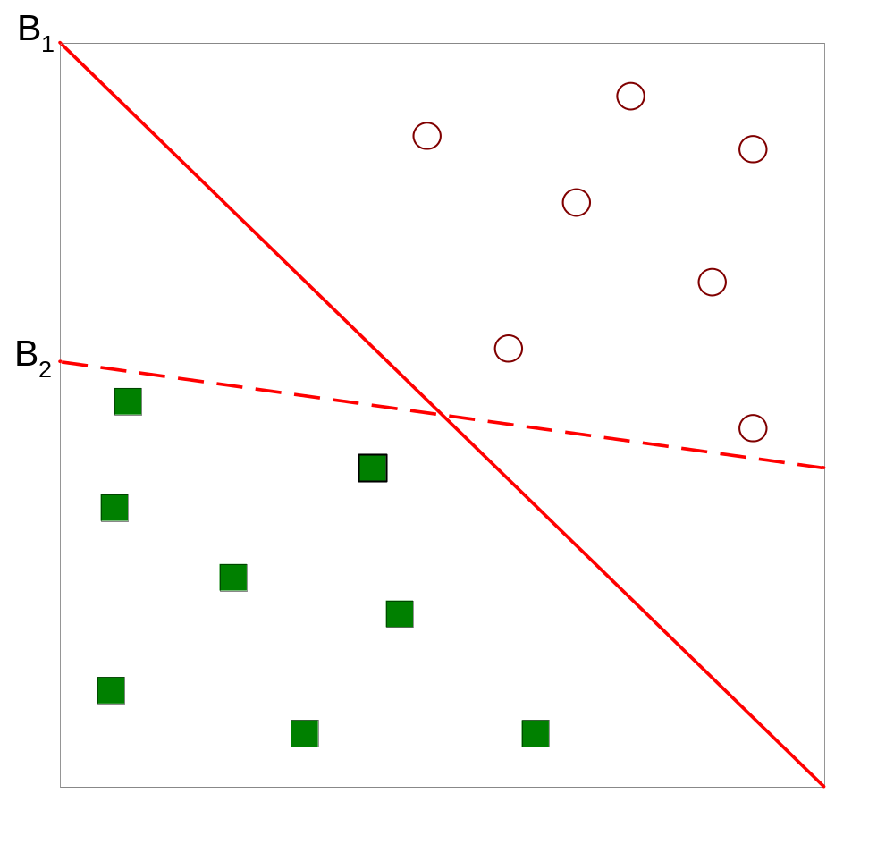
Support Vector Machines
Which one is better? B1 or B2?
How do you define better?

Slide 12
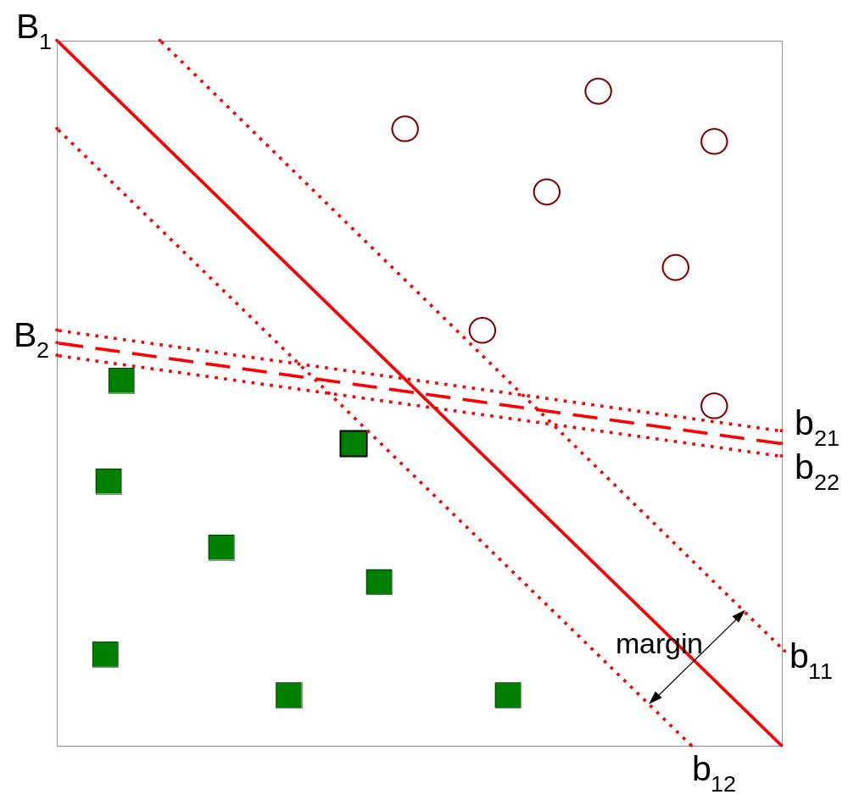
Support Vector Machines
Find hyperplane maximizes the margin => B1 is better than B2

Slide 13
Support Vector Machines
Rationale for Maximum Margin
Decision boundaries with large margin tend to have better generalization errors
Large margin implies there is a high confidence in classification
Intuitively, if the margin is small, then any slight perturbation to the decision boundary can have quite a significant impact on its classification
Classifiers that produce decision boundaries with small margins are therefore more susceptible to overfitting and tend to generalize poorly on previously unseen examples
The decision boundary is referred to as a hyperplane

Slide 14

Linear SVM: Separable Case
A linear SVM is a classifier that searches for a hyperplane with the largest margin
It is also called maximum margin classifiers
Consider a binary classification problem with N training examples.
Each example is denoted by a tuple (x_{i}, y_{i}) (i = 1,2,…N). Here x_{i} = (x_{i1,} x_{i2, ….} x_{id}) corresponds to the attribute set for the i^{th} training example. Let the class label be denoted by y_{i} = -1 for the negative class and y_{i} = +1 for the positive class
The decision boundary of a linear classifier can be written in the following form:
Here, w and b are parameters of the model
w is a vector of the same dimension as the number of dimensions of the data

Slide 15
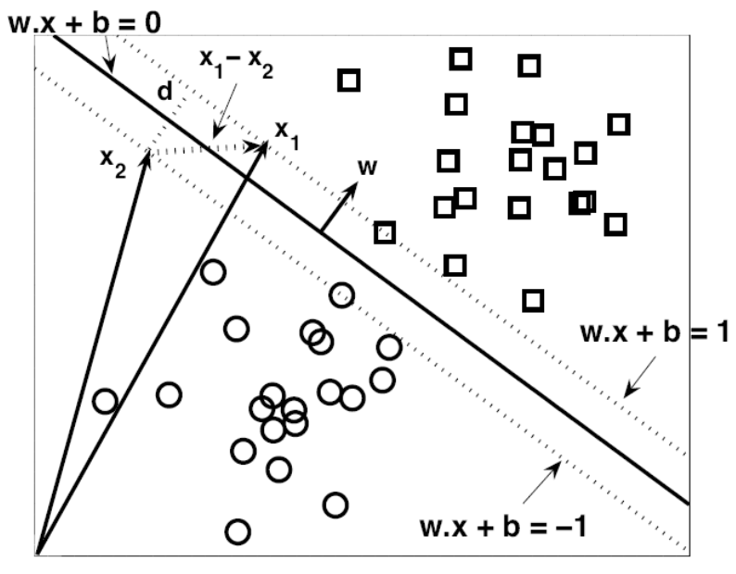



Linear SVM: Separable Case
A two dimensional dataset with two classes – squares and circles
Data is linearly separable
A decision boundary that bisects the training examples into their respective classes is denoted with a solid line
Any point located on this line will satisfy the equation of the line
Let x_{a} and x_{b} denote two points located on the decision boundary. We then have
Subtracting, we get
Here, x_{b} – x_{a} is a vector parallel to the decision boundary and is directed from x_{a} to x_{b}
Since the dot product is 0, the direction of w must be perpendicular to the decision boundary, as shown in the figure

Slide 16


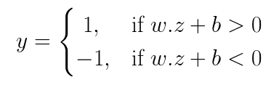
Linear SVM: Separable Case
For any square x_{s} located above the decision boundary, we can show that:
Similarly, for any circle x_{c} located below the decision boundary, we can show that:
If we label all the squares as class +1 and all the circles as class -1, then we can predict the class label y for any test sample z as follows:

Slide 17


Linear SVM: Separable Case
Consider the square and the circle that are closest to the decision boundary
These two points are equidistant from the decision boundary (so that we have maximum margin of separation)
Since the square is located above the decision boundary, it must satisfy w.x + b = k, k > 0
Since the circle is located below the decision boundary (at the same distance), it must satisfy w.x + b = - k
We can rescale the parameters w and b in our model so that these two lines can be expressed as:

Slide 18





Linear SVM: Separable Case
The margin (d) of the decision boundary is given by the distance between these two hyperplanes
Consider the data points x1 and x2 as shown
These two data points will satisfy the following equations:
Subtracting, we get:
Taking magnitude on both sides of the equation

Slide 19



Linear SVM: Separable Case
Training an SVM involves estimating the parameters w and b from the training data
The parameters must be chosen in such a way that the following two conditions are met:
These conditions impose the requirements that all training instances from class y = 1 (the squares) must be located on or above the hyperplane w.x + b = 1 while those instances with class y = -1 (the circles) must be located on or below the hyperplane w.x + b = -1
We can combine both inequalities in a single inequality as follows:

Slide 20
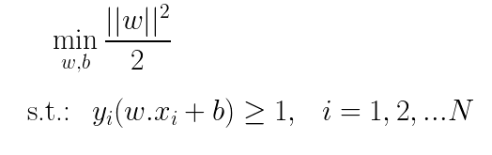
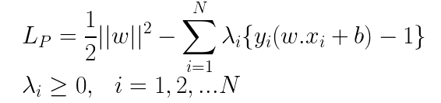
Linear SVM: Separable Case
The learning task in an SVM can be formalized as the following optimization problem
Maximize margin
All training samples are correctly classified
This problem is solved by the method of Lagrangian multipliers
We rewrite the objective function in a form that takes into account the constraints imposed on its solutions:
Primal Problem
Lagrangian multipliers
Corresponding to every training sample, we have a Lagrangian multiplier, which are greater than or equal to 0

Slide 21
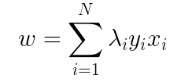
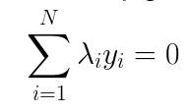
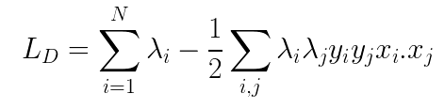
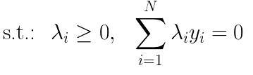
Linear SVM: Separable Case
From the primal problem, we get (skipping the mathematical details):
Substituting back in the primal problem, we get the dual problem (skipping the mathematical details):
QP problem
The dual Lagrangian involves only the Lagrangian multipliers and the training data, while the primary Lagrangian involves the Lagrangian multipliers as well as the parameters of the decision boundary. The solutions for both problems are equivalent
The dual problem can be solved using quadratic programming solvers to derive the Lagrangian multipliers

Slide 22

Linear SVM: Separable Case
Once we solve the Lagrangian multipliers, we have:
The dual problem also satisfies the following (skipping mathematical details):
b is obtained by solving this equation for the training samples that have a non-zero Lagrangian multiplier
Since the Lagrangian multipliers are calculated numerically, they may have numerical errors
Thus, the solution to b may not be unique (each training sample may lead to a slightly different solution for b)
In practice, an average value of b is chosen as the final solution

Slide 23
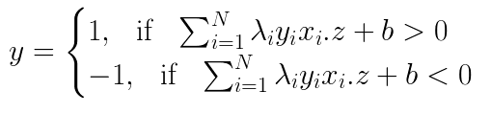
Linear SVM: Separable Case
Classifying a test sample
We had the following decision rule, for a test sample z
Substituting w, we have:

Slide 24
Linear SVM: Separable Case
Support Vectors
Consider the solution to the variable w obtained before:
Each training sample x_{i} has a label y_{i} and a Lagrangian multiplier associated with it
The label y can be +1 or -1
The Lagrangian multipliers can be greater than or equal to 0
The solution to w depends only the training samples with non-zero Lagrangian multipliers; a training sample with Lagrangian multiplier equal to 0 will not contribute to the summation in the solution to w
The training samples with non-zero Lagrangian multipliers are called the support vectors (SVs)
The decision boundary depends only on the support vectors (these training vectors support the decision boundary); hence, the model is called a support vector machine (SVM)

Slide 25


Linear SVM: Separable Case
Support Vectors
We also had the following equation:
For the support vectors:
SVs
The support vectors must lie along the hyperplanes
This makes intuitive sense since these samples decide how the hyperplane is going to look
The solution to the hyperplane depends only on these samples

Slide 26
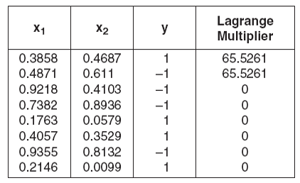
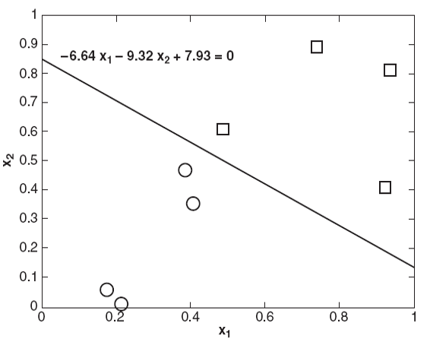
Linear SVM: Separable Case
Example: Consider the two dimensional training dataset as shown and the corresponding Lagrangian multipliers. Find the parameters w and b of the linear SVM
Let w = (w1,w2) and b denote the parameters of the SVM

Slide 27


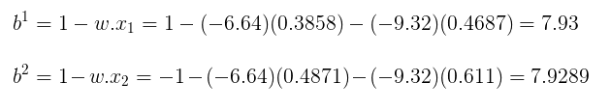

Linear SVM: Separable Case
b is obtained by solving this equation for each of the support vectors:
For the support vectors, the Lagrangian multipliers are non-zero. We thus have
For the given problem, we have
From First SV
From Second SV
Averaging these values, we have

Slide 28
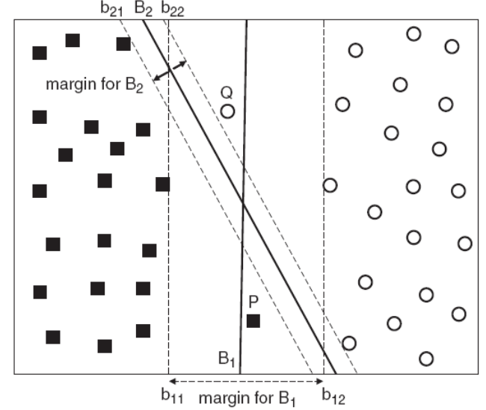
Linear SVM: Non-Separable Case
Consider the dataset in the adjoining figure
It is similar to the previous dataset, but has two new examples P and Q
The decision boundary B1 misclassifies the new examples, but B2 classifies them correctly
But, this does not mean that B2 is a better decision boundary because the new examples may be noisy training samples
B1 is still preferred over B2 as it has a wider margin and is less susceptible to overfitting
The SVM formulation described previously constructs decision boundaries that are mistake-free
This is called the hard-margin formulation
For the non-separable case, we modify the formulation to learn a decision boundary that is tolerable to small training errors
This is known as the soft-margin formulation

Slide 29



Linear SVM: Non-Separable Case
Soft margin SVM considers the trade-off between the width of the margin and the number of training errors committed by the linear decision boundary
Previously, we had the following inequality constraints for the hard-margin formulation
We now relax the constraints to accommodate non-linearly separable data
This can be done by introducing positive-valued slack variables into the constraints of the optimization problem:
Slack variables
Large values of the slack variables imply that a lot of training instances are misclassified
This should not be encouraged
Thus, large values of the slack variables should be penalized

Slide 30
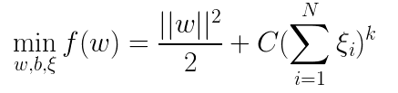
Linear SVM: Non-Separable Case
The objective function must be modified to penalize a decision boundary with large values of the slack variables
The modified optimization problem for soft-margin SVMs is given by:
C and k are parameters representing the penalty of misclassifying the training instances
k is usually selected as 1 to simplify the problem; C is chosen based on the model’s performance on a validation set
Solution process is similar to the hard-margin formulation (using the method of Lagrangian multipliers)

Slide 31
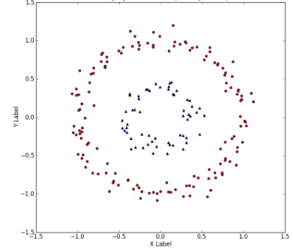
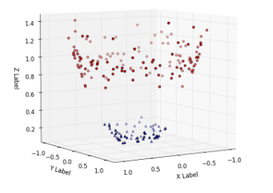


Nonlinear SVM
2D space
3D space
What if the data is not linearly separable (decision boundary is non-linear) ?
If the data is projected to a higher dimensional space, there is a good chance that the data will be linearly separable

Slide 32
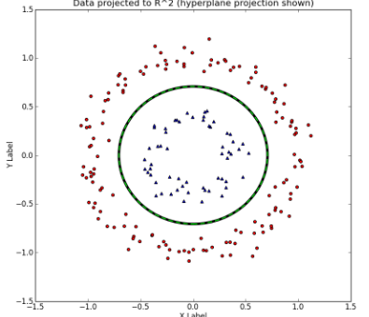
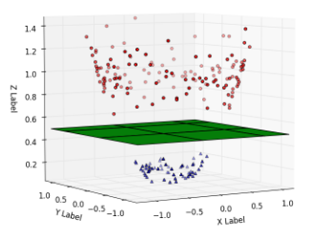
Nonlinear SVM
3D space
2D space
Overall Idea
Use a non-linear transformation Ø to transform the data from the lower dimensional space to the higher dimensional space
Train a linear SVM in the higher dimensional space
Project the linear decision boundary from the higher dimensional space to the lower dimensional space

Slide 33
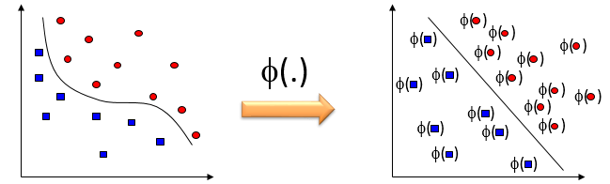
Nonlinear SVM
Lower Dimensional Space
Input Space
Original Attribute Space
Higher Dimensional Space
Feature Space
Kernel Space
Hilbert Space
Challenges
The mapping function Ø is an unknown
Solving the optimization problem in the higher dimensional space is computationally expensive
Curse of Dimensionality

Slide 34
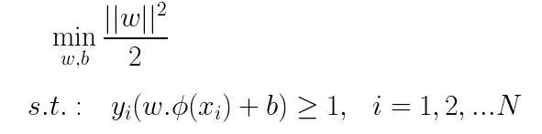
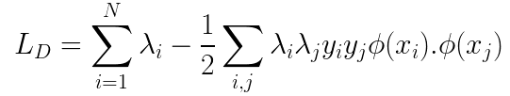
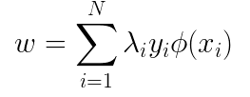
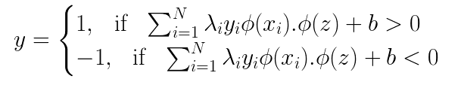
Nonlinear SVM
Let us for the moment, assume that the transformation function Ø (x) is known and try to solve the linear SVM in the higher dimensional space
Our previous hard-margin formulation
Current formulation
Learning Problem
Learning Problem
Dual Problem
Dual Problem
Solving w
Solving w
Predicting a test sample
Predicting a test sample

Slide 35
Nonlinear SVM
An important observation
Training Phase:
Dot Product
Testing Phase:
Dot Product
In both the training and test equations, the transformed vectors occur ONLY in the form of dot products
The dot product is often regarded as a measure of similarity between two vectors
For instance, the cosine similarity can be regarded as the dot product between two vectors of unit length
Analogously, the dot product between Ø(x_{i}) and Ø(x_{j}) can also be regarded as a measure of similarity between the two instances x_{i} and x_{j} in the feature space

Slide 36

Nonlinear SVM
The dot product in the feature space can be expressed in terms of a similarity function in the original space:
The similarity function K is called a kernel function
However, any similarity function cannot be used as a kernel
The kernel function computed for a pair of vectors should be equivalent to the dot product between the vectors in the feature space, that is it should satisfy the above equation
This condition is ensured by Mercer’s Theorem

Slide 37
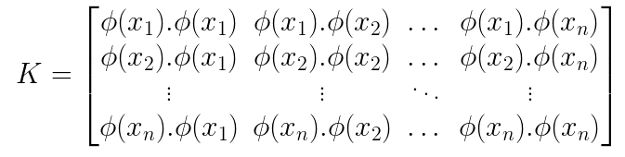
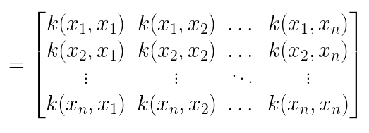
Nonlinear SVM
Consider we are given n training samples x₁, x₂, …. x_{n}
We can use the function K to create an n by n matrix as shown below
This matrix is also called the kernel matrix or Gram matrix

Slide 38
Nonlinear SVM
Mercer’s Theorem
The function k(:,:) is a valid kernel if and only if the corresponding Gram matrix is symmetric and positive semi-definite (PSD)
Kernels that satisfy Mercer’s Theorem are also called Mercer kernels
Mercer’s Theorem enables us to compute the similarities in the transformed space using the original attribute set
This is also known as the kernel trick
As long as we have a valid kernel, we don’t need to know the exact form of the mapping function Ø and the exact form the training samples in the feature space Ø(x)
Thus, the entire idea of projecting the data to a higher dimensional feature space and training an SVM in the feature space is a theoretical construct
In practice, the entire computation is done in the lower dimensional input space itself
Since the computations are performed in the original space, the curse of dimensionality can be avoided
Computing the similarity using kernel functions is much cheaper than using the transformed features

Slide 39
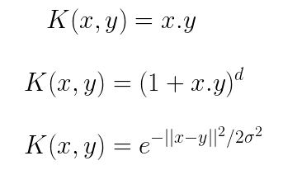
Nonlinear SVM
Commonly used kernels
Linear Kernel
Polynomial Kernel of degree d
Gaussian or Radial Basis Function (RBF) Kernel

Slide 40
Multiclass SVM
SVMs are originally designed for binary classification problems
Many real-world problems are multi-class – that is, they have more than two class labels
Let Y = {y_{1,} y_{2,….} y_{K}} be the set of K classes in the input data
There are two common approaches to handle this setting:
  One-against-rest (1-r) approach: It decomposes the multi-class problem into K binary problems. For each class y_{i} a binary problem is created where all instances that belong to y_{i} are considered positive examples, while the remaining examples are considered negative examples. A binary SVM is then trained to separate the positive and the negative examples.
  One-against-one (1-1) approach: This approach constructs K(K-1)/2 binary classifiers, where each classifier is used to distinguish between a pair of classes (y_{i,} y_{j}). Instances that do not belong to either y_{i} or y_{j} are ignored while constructing the binary classifier for (y_{i,} y_{j}).
  In both (1-r) and (1-1) approaches, a test instances is classified by combining the predictions made by the binary classifiers. A voting scheme is typically employed to combine the predictions, where the class that receives the highest number of votes is assigned to the test instance. In the 1-r approach, if an instance is classified as negative, then all classes except for the positive class receive a vote. In the 1-1 approach, a class receives a vote if the prediction matches the label of the class

Slide 41
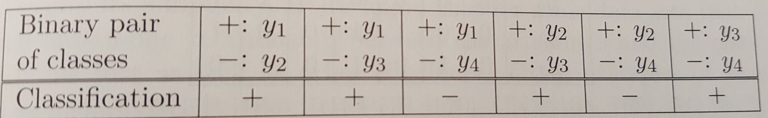
Multiclass SVM
Example: Consider a multi-class problem where Y = {y_{1,} y_{2,} y_{3,} y₄ }. Suppose a test sample is classified as (+, -, -, -) according to the 1-r approach. In other words, it is classified as positive when y₁ is used as the positive class and negative when y_{2,} y_{3,} y₄ are used as the positive class. Using a majority voting scheme, we note that y₁ receives the highest number of votes, which is 4, while the remaining classes receive only 3 votes. The test instance is therefore classified as y_{1.}
Suppose the test example is classified as follows using the 1-1 approach:
The first row in the table denotes the pair of classes chosen to build the classifier and the last row represents the predicted class for the test instance. After combining the predictions, y₁ and y₄ each receive 2 votes while y₂ and y₃ each receive only one vote. The test instance is therefore classified as either y₁ or y₄ depending on the tie breaking procedure.

Slide 42
SVM Characteristics
The SVM learning problem can be formulated as a convex optimization problem in which efficient algorithms can be used to find the global minimum of the objective function. Other learning algorithms like neural networks find the local optimum
SVMs maximize the margin of the decision boundary; they are also called maximum margin models. The user needs to provide parameters like the type of the kernel function and the kernel parameters and the value of the constant C to introduce the slack variables
SVMs can be applied to categorical data by introducing dummy variables for each categorical attribute value present in the data. For example, if marital states has three values {Single, Married, Divorced}, we can introduce a binary variables for each of the attribute values
SVMs can be used for multiclass classification using the one-against-rest or the one-against-one approaches

